Slide 1
Binary Trees
Chapter 11
Notes:
1

Slide 2
Chapter Contents
Introduction
Implementing Binary Search Trees
Binary Search Tree Traversal Algorithms
Binary Search Trees Building Algorithms
Binary Search Trees Applications

Slide 3
Objectives
Explore nonrecursive binary tree traversal algorithms
Learn about AVL (height-balanced) trees
Learn about B-trees

Slide 4
Objectives
Explore various binary tree traversal algorithms
Learn how to organize data in a binary search tree
Discover how to insert and delete items in a binary search tree
Explore nonrecursive binary tree traversal algorithms
Learn about AVL (height-balanced) trees
Learn about B-trees

Slide 5
Binary Search Trees (cont’d.)
Operations performed on a binary search tree
Search the binary search tree for a particular item
Insert an item in the binary search tree
Delete an item from the binary search tree
Find the height of the binary search tree
Find the number of nodes in the binary search tree
Find the number of leaves in the binary search tree
Traverse the binary search tree
Copy the binary search tree

Slide 6
Binary Search Trees (cont’d.)
Every binary search tree is a binary tree
Height of a binary search tree
Determined the same way as the height of a binary tree
Operations to find number of nodes, number of leaves, to do inorder, preorder, postorder traversals of a binary search tree
Same as those for a binary tree
Can inherit functions

Slide 7
Binary Search Trees (cont’d.)
class bSearchTreeType
Illustrates basic operations to implement a binary search tree
See code on page 618
Function search
Function insert
Function delete

Slide 8
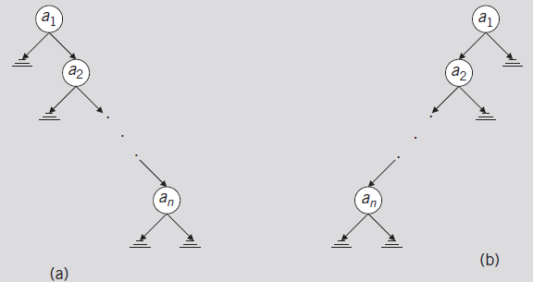
Binary Search Tree: Analysis
Worst case
T: linear
Successful case
Algorithm makes (n + 1) / 2 key comparisons (average)
Unsuccessful case: makes n comparisons
FIGURE 11-10 Linear binary trees

Slide 9
Binary Search Tree: Analysis (cont’d.)
Average-case behavior
Successful case
Search would end at a node
n items exist, providing n! possible orderings of the keys
Number of comparisons required to determine whether x is in T
One more than the number of comparisons required to insert x in T
Number of comparisons required to insert x in T
Same as number of comparisons made in the unsuccessful search reflecting that x is not in T

Slide 10
Binary Search Tree: Analysis (cont’d.)

Slide 11
Binary Search Tree: Analysis (cont’d.)
Theorem: let T be a binary search tree with n nodes, where n> 0
The average number of nodes visited in a search of T is approximately 1.39log₂n =O(log₂n)
The number of key comparisons is approximately 2.77 log₂n = O(log₂n)

Slide 12
Nonrecursive Inorder Traversal

Slide 13
Nonrecursive Inorder Traversal (cont’d.)

Slide 14
Nonrecursive Preorder Traversal

Slide 15
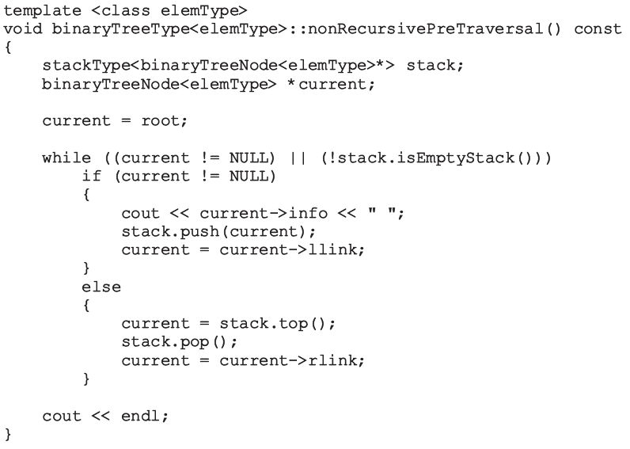
Nonrecursive Preorder Traversal (cont’d.)

Slide 16
Nonrecursive Postorder Traversal

Slide 17
AVL (Height-Balanced) Trees (cont’d.)

Slide 18
AVL (Height-Balanced) Trees (cont’d.)
Definition of a node in the AVL tree

Slide 19
AVL (Height-Balanced) Trees (cont’d.)
AVL binary search tree search algorithm
Same as for a binary search tree
Other operations on AVL trees
Implemented exactly the same way as binary trees
Item insertion and deletion operations on AVL trees
Somewhat different from binary search trees operations

Slide 20
Insertion
First search the tree and find the place where the new item is to be inserted
Can search using algorithm similar to search algorithm designed for binary search trees
If the item is already in tree
Search ends at a nonempty subtree
Duplicates are not allowed
If item is not in AVL tree
Search ends at an empty subtree; insert the item there
After inserting new item in the tree
Resulting tree might not be an AVL tree

Slide 21
Insertion (cont’d.)
FIGURE 11-14 AVL tree before and after inserting 90
FIGURE 11-15 AVL tree before and after inserting 75

Slide 22
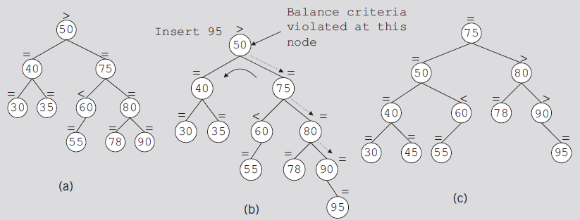
Insertion (cont’d.)
FIGURE 11-16 AVL tree before and after inserting 95
FIGURE 11-17 AVL tree before and after inserting 88

Slide 23
AVL Tree Rotations
Rotating tree: reconstruction procedure
Left rotation and right rotation
Suppose that the rotation occurs at node x
Left rotation: certain nodes from the right subtree of x move to its left subtree; the root of the right subtree of x becomes the new root of the reconstructed subtree
Right rotation at x: certain nodes from the left subtree of x move to its right subtree; the root of the left subtree of x becomes the new root of the reconstructed subtree

Slide 24
FIGURE 11-18 Right rotation at b
FIGURE 11-19 Left rotation at a

Slide 25
FIGURE 11-20 Double rotation: First rotate left at a and then right at c
FIGURE 11-21 Left rotation at a followed by a right rotation at c

Slide 26
AVL Tree Rotations (cont’d.)
FIGURE 11-22 Double rotation: First rotate right at c,
then rotate left at a

Slide 27
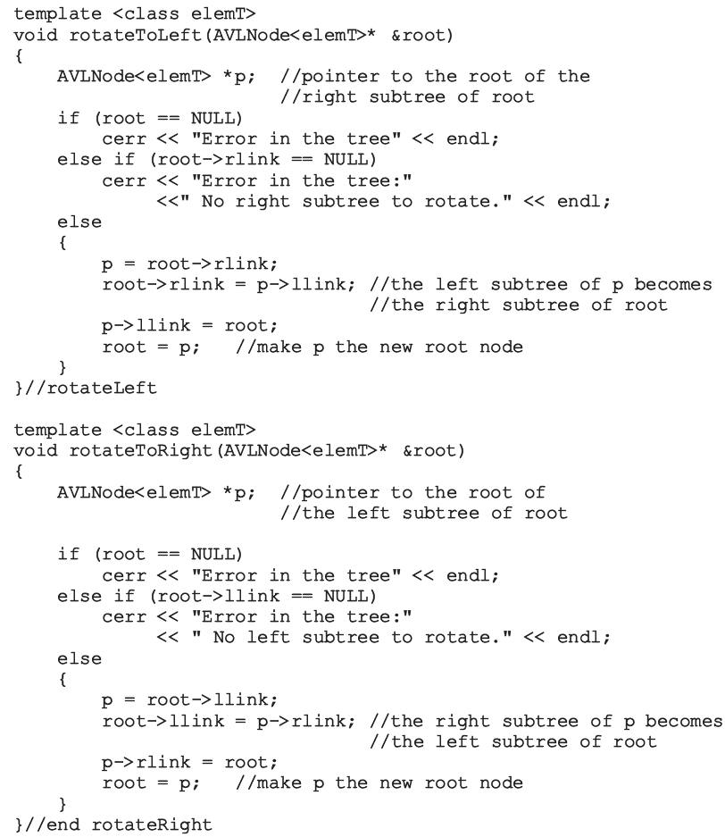

Slide 29
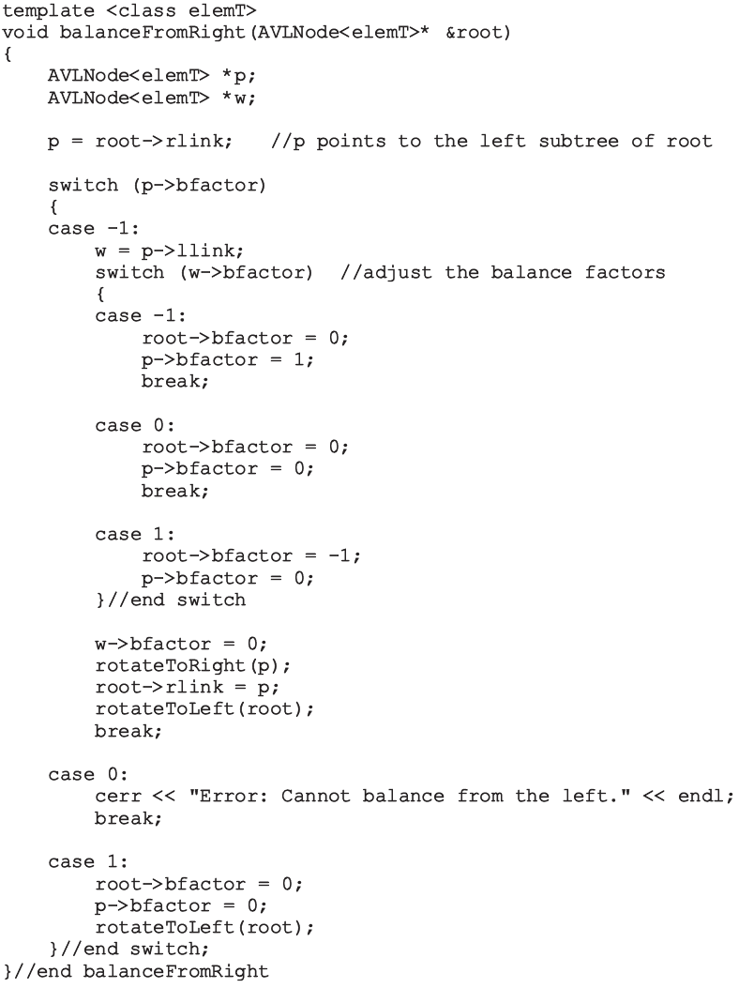

Slide 30
AVL Tree Rotations (cont’d.)
Steps describing the function insertIntoAVL
Create node and copy item to be inserted into the newly created node
Search the tree and find the place for the new node in the tree
Insert new node in the tree
Backtrack the path, which was constructed to find the place for the new node in the tree, to the root node
If necessary, adjust balance factors of the nodes, or reconstruct the tree at a node on the path

Slide 31
FIGURE 11-23 Item insertion into an initially empty AVL tree

Slide 32
AVL Tree Rotations (cont’d.)
Function insert
Creates a node, stores the info in the node, and calls the function insertIntoAVL to insert the new node in the AVL tree

Slide 33
Deletion from AVL Trees
Four cases
Case 1: The node to be deleted is a leaf
Case 2: The node to be deleted has no right child, that is, its right subtree is empty
Case 3: The node to be deleted has no left child, that is, its left subtree is empty
Case 4: The node to be deleted has a left child and a right child
Cases 1–3
Easier to handle than Case 4

Slide 34
Analysis: AVL Trees
Consider all possible AVL trees of height h
Let T_{h} be an AVL tree of height h such that T_{h} has the fewest number of nodes
Let T_{hl} denote the left subtree of T_{h} and T_{hr} denote the right subtree of T_{h}
Then:
where |T_{h}| denotes the number of nodes in T_{h}

Slide 35
Analysis: AVL Trees (cont’d.)
Suppose:
T_{hl} is of height h – 1 and T_{hr} is of height h – 2
T_{hl} is an AVL tree of height h – 1 such that T_{hl} has the fewest number of nodes among all AVL trees of height h – 1
T_{hr} is an AVL tree of height h – 2 that has the fewest number of nodes among all AVL trees of height h – 2
T_{hl} is of the form T_{h} -1 and T_{hr} is of the form T_{h} -2
Hence:

Slide 37
B-Trees
Leaves on the same level
Not too far from the root
m-way search tree
Tree in which each node has at most m children
If the tree is nonempty, it has the following properties:

Slide 38
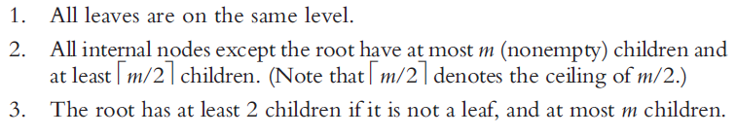
B-Trees (cont’d.)
B-tree of order m
m-way search tree
Either empty or has the following properties:
Basic operations
Search the tree, insert an item, delete an item, traverse the tree

Slide 39
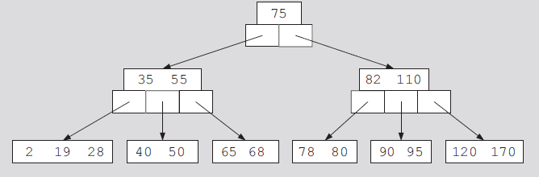
B-Trees (cont’d.)
FIGURE 11-24 A 5-way search tree
FIGURE 11-25 A B-tree of order 5

Slide 40
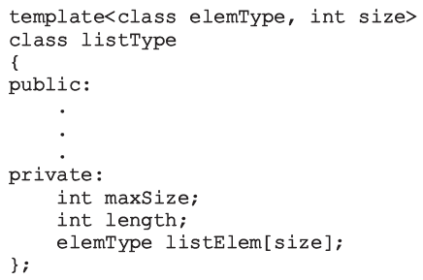
B-Trees (cont’d.)
Constant expressions
May be passed as parameters to templates
Definition of a B-tree node
Class implementing B-tree properties
See code on pages 664-665
Implements B-tree basic properties as an ADT

Slide 41
Search
Searches binary search tree for a given item
If item found in the binary search tree: returns true
Otherwise: returns false
Search must start at root node
More than one item in a node (usually)
Must search array containing the data
Two functions required
Function search
Function searchNode
Searches a node sequentially

Slide 42
Traversing a B-Tree
B-tree traversal methods
Inorder, preorder, postorder

Slide 43
Insertion into a B-Tree
Algorithm: search tree to see if key already exists
If key already in the tree: output an error message
If key not in the tree: search terminates at a leaf
Record inserted into the leaf: if room exists
If leaf full: split node into two nodes
Median key moved to parent node (median determined by considering all keys in the node and new key)
Splitting can propagate upward (even to the root)
Causing tree to increase in height

Slide 44
Insertion into a B-Tree (cont’d.)
Function insertBTree
Recursively inserts an item into a B-tree
Function insert uses function insertBTree
Function insertNode
Inserts item in the node
Function splitNode
Splits node into two nodes
Inserts new item in the relevant node
Returns median key and pointer to second half of the node

Slide 45
FIGURE 11-26 Item insertion into a B-tree of order 5
FIGURE 11-27 Insertion of 73, 54, 98, and 37
FIGURE 11-28 Insertion of 25, 62, 81, 150, and 79

Slide 46
FIGURE 11-29 Insertion of 200

Slide 47
Deletion from a B-Tree
Case to consider

Slide 48
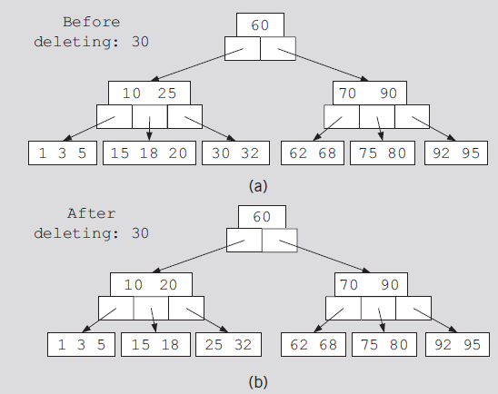
FIGURE 11-30 A B-tree of order 5
FIGURE 11-31 Deleting 18 from
a B-tree of order 5
FIGURE 11-32 B-tree before and after deleting 30

Slide 49
FIGURE 11-33 Deletion of 70 from the B-tree

Slide 50
Summary
This chapter discussed
Binary trees
Binary search trees
Recursive traversal algorithms
Nonrecursive traversal algorithms
AVL trees
B-trees

